Slide 1
Chapter 1 Observation Skills
By the end of this chapter you will be able to:
Define Forensic Science and what forensic scientists do.
Define observation and describe what changes occur in the brain
Describe examples of factors influencing eyewitness accounts of events
Compare the reliability of eyewitness testimony with what actually happened
Practice and improve your observation skills
Discuss the consequence of poor eye witness account
Forensic Science: Fundamentals & Investigations, Chapter 1

Slide 2
What is forensic science?
Study of evidence in a crime to be used in a legal system
Forensic Science: Fundamentals & Investigations, Chapter 1

Slide 3
The forensic examiner must be able to
Find — identify the evidence (observation)
Document — record the evidence
Interpret — accurately determine the significance of the evidence then analyze it
Provide expert testimony to courts
Forensic Science: Fundamentals & Investigations, Chapter 1

Slide 4
What Is Observation?
Observation: What a person perceives using his or her senses
Perception: Interpreting information received from the senses
Activitiy: Observe the next screen for 30 seconds. You are NOT allowed to write anything down. You CANNOT talk to anyone else.
Forensic Science: Fundamentals & Investigations, Chapter 1

Slide 5
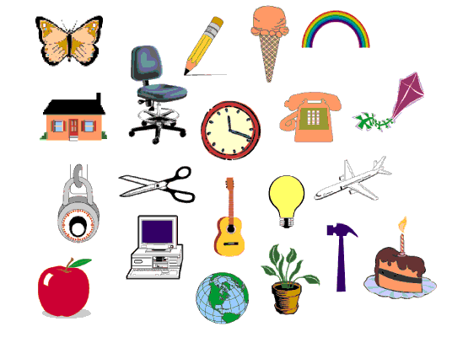
Items to remember ...
Neuroscience for Kids - http://faculty.washington.edu/chudler/puzmatch1.html

Slide 6
You have 2 minutes to list as many of the items as you can!
What do you remember?
How did you do?
All 20 – Awesome
15-19 – Great
10-14 – Pretty swell
5-9 – Could be better
4 or Less – Wake up
Notes:
Teacher Note: Try to influence the students’ memory of the items. As they are writing down the items they remember, suggest two or three items that were not shown, such as a banana (on the info slide), a nail (goes with hammer), or pen (instead of the pencil). As you go over the correct items, ask the students if they added any of the ones you told them to remember. Tie this into the discussion (next slide) on how a person’s memory can be affected by another person.

Slide 7
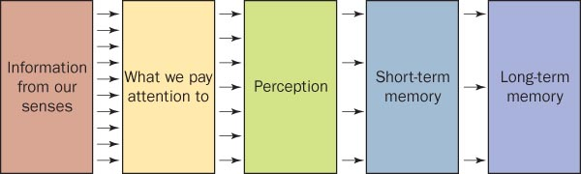
How information is processed in the brain when we observe
Forensic Science: Fundamentals & Investigations, Chapter 1

Slide 8

Crime Scene Challenge
Now that your eyes and brain are warmed up, let’s test your observation skills a bit more.
You will have 2 minutes to study the photograph of a crime scene on the next slide.
Try to pay attention to details as you will be asked 10 questions about the crime scene!
You are not allowed to write anything down until after the time is up.
Ready?

Slide 9
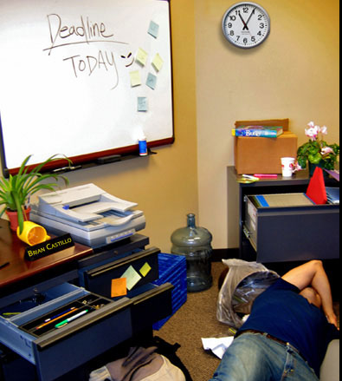

Slide 10
Answer each question below.
1. What color coffee mug was in the picture? Blue Red Yellow
2. When was the deadline? Yesterday Today Tomorrow
3. What time was on the clock on the wall? 10:40 11:05 1:55
4. How many sticky notes were on the whiteboard? Four Six Eight
5. Which of the following was NOT in the picture? Stapler Trash Can Printer
6. What was the name on the plaque on the desk? Bill Brian Carl
7. What color was the victim's shirt? Black Blue Red
8. How many plants were in the picture? None One Two
9. What was the color of the marker in the desk drawer? Red Blue Green
10. Where was the book in the picture? On a box In the trash can Under the body
Source: http://forensics.rice.edu/html/picture_begin.html

Slide 11
Discussion
After observing the picture, what type of information did you miss?
And what type of information did you assume?
Forensic Science: Fundamentals & Investigations, Chapter 1

Slide 12

How can observation be faulty?
Our brains can filter out information.
Our brains fill in gaps in our perception.
Observations are affected by:
Their emotional states
Whether they were alone, part of a group, or near others
What type of and how much activity was going on around them
The Bunny Effect
CBS News Video
Forensic Science: Fundamentals & Investigations, Chapter 1

Slide 13
Did you know?
According to The Innocence Project (2008) "Eyewitness misidentification is the single greatest cause of wrongful convictions nationwide, playing a role in more than 75% of convictions overturned through DNA testing." Still, the criminal justice system profoundly relies on eyewitness identification and testimony for investigating and prosecuting crimes (Wells & Olson, 2003).
What factors affect a person’s memory and their ability to identify a suspect?
Source: http://www.helium.com/items/1276135-accurate-eyewitness-accounts

Slide 14
The Innocence Project
Barry C. Scheck and Peter J. Neufeld (OJ Simpson’s Lawyers) from Benjamin N. Cardozo School of Law,
Beginning in 1992, used DNA to examine post-conviction cases
Faulty eyewitness identifications accounted for up to 87% of the wrongful convictions
Forensic Science: Fundamentals & Investigations, Chapter 1

Slide 15
Eyewitness Accounts
Crime-scene reports often vary, due to:
  level of interest
  stress
  concentration
  amount and kind of distractions present
  prejudices
  personal beliefs
  Motives
  age
  any lapse in time since the event
Forensic Science: Fundamentals & Investigations, Chapter 1

Slide 16
How to be a Good Observer
Observe systematically (i.e. use a pattern to study the room)
Turn off filters
Collect Information first, interpret data later
Documentation,
Documentation,
Documentation
Forensic Science: Fundamentals & Investigations, Chapter 1

Slide 17
Observations in Forensics
Study situations
Find clues in ordinary details
Work backwards from the evidence to what led up to the crime
Be patient
Acquiring good observation skills takes practice and training
Example: Sherlock Holmes
(Deductive reasoning: a logical process in which a conclusion is based on the accordance of multiple premises that are generally assumed to be true.)
Forensic Science: Fundamentals & Investigations, Chapter 1

